Slide 1
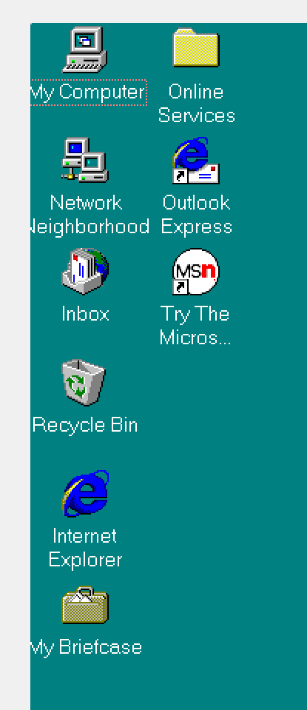
Welcome to ClassicPPT
Type a username and password to log on to ClassicPPT.
?
OK
Inbox

Slide 2

Please wait while your computer
shuts down.
MoMusician’s
Classic
PPT

Slide 3

MoMusician’s
Classic
PPT

Slide 6
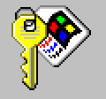
Welcome to ClassicPPT
?
Type a username and password to log on to ClassicPPT.
OK
Cancel
User name:
Password:

Slide 7
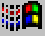
My Computer
Online Services
Network
Neighborhood
Outlook Express
Inbox
Try The Micros…
Recycle Bin
Internet Explorer
My Briefcase
Start

Slide 8
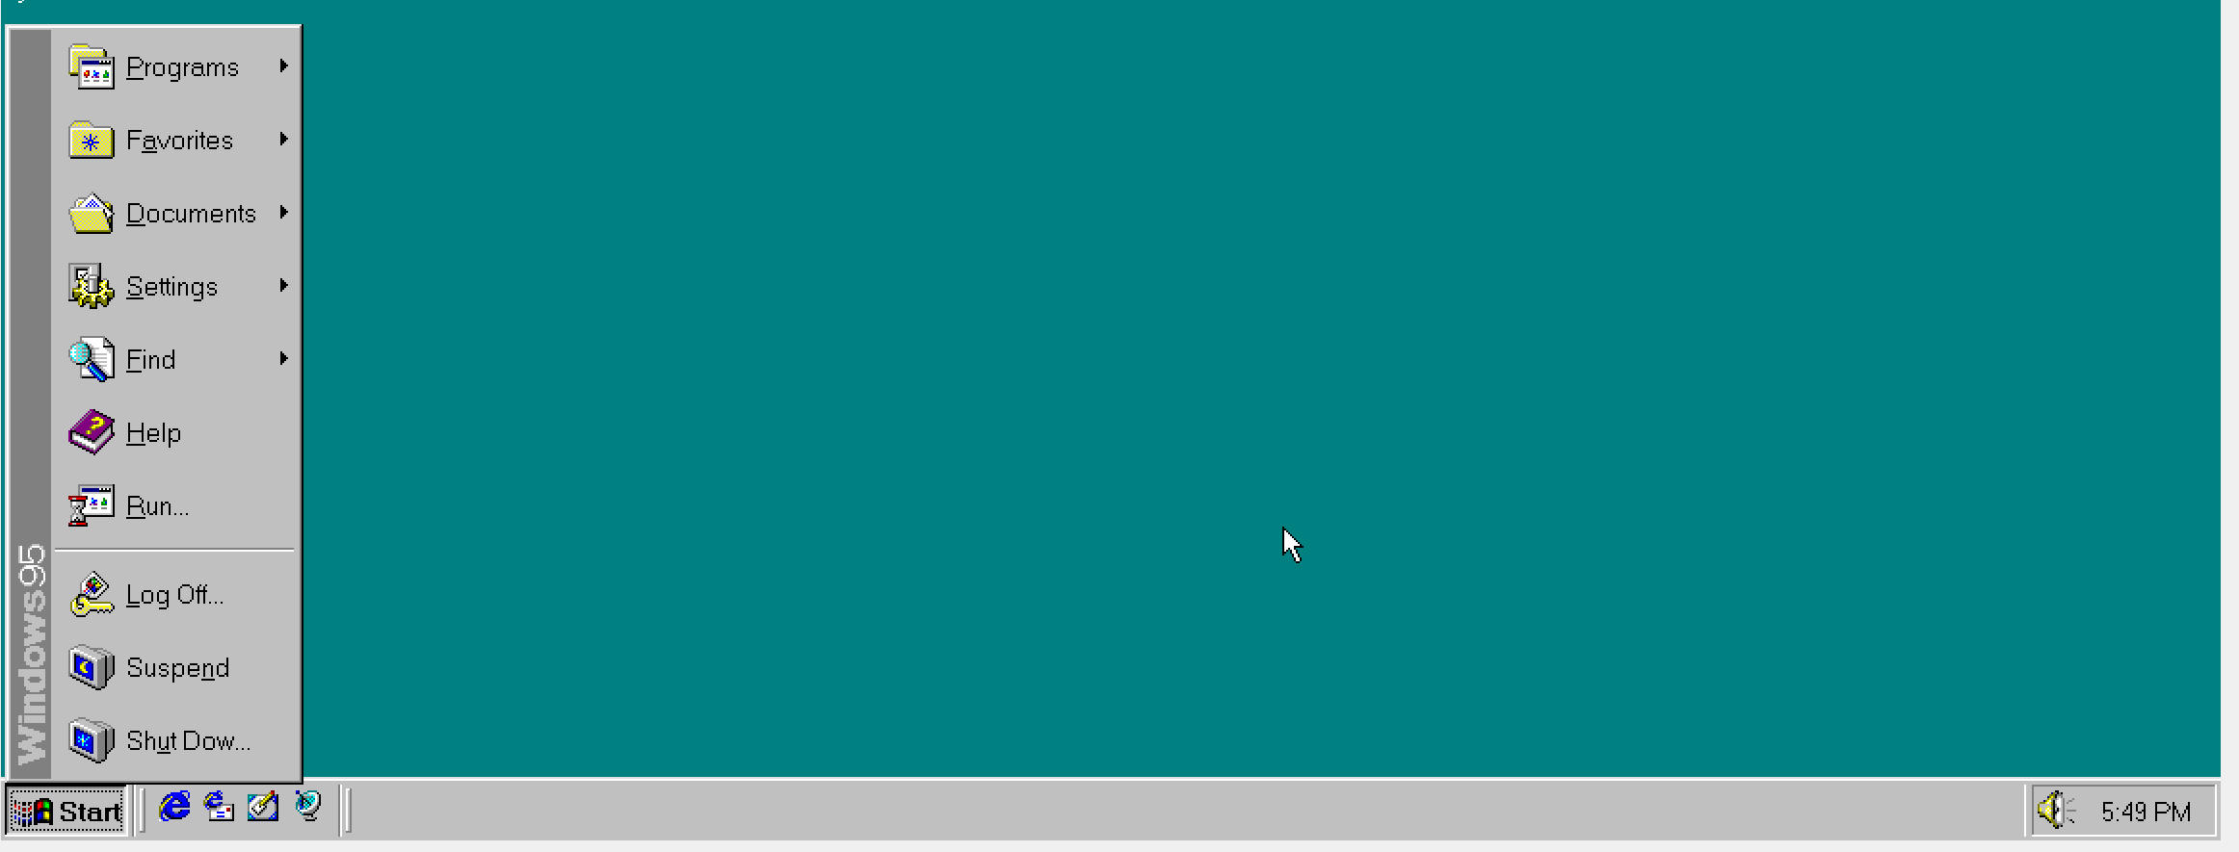
My Computer
Online Services
Network
Neighborhood
Outlook Express
Inbox
Try The Micros…
Recycle Bin
Programs
Internet Explorer
Favorites
Documents
My Briefcase
Settings
Find
Help
Run…
Log Off…
ClassicPPT
Suspend
Shut Down…
Start

Slide 9

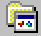
My Computer
Online Services
Network
Neighborhood
Outlook Express
Inbox
Try The Micros…
Recycle Bin
Accessories
Programs
Internet Explorer
Favorites
Online Services
Internet Explorer
StartUp
Documents
Microsoft NetMeeting
MS-DOS Prompt
My Briefcase
Settings
Windows Explorer
Find
Help
Run…
Log Off…
ClassicPPT
Suspend
Shut Down…
Start

Slide 10
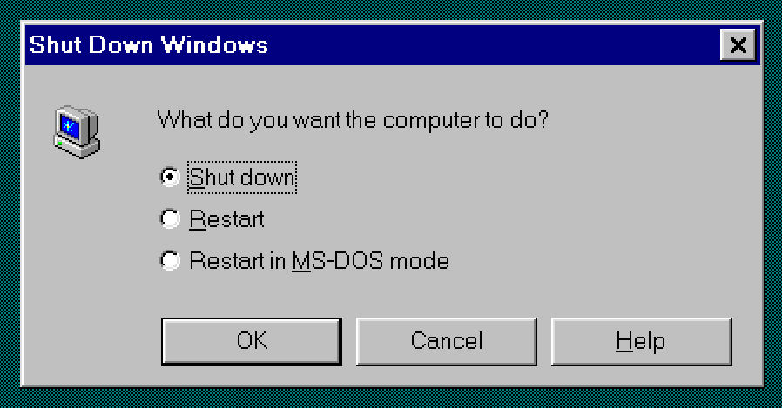
My Computer
Online Services
Network
Neighborhood
Outlook Express
Inbox
Try The Micros…
Recycle Bin
Shut Down ClassicPPT
What do you want the computer to do?
Shut down
Internet Explorer
Restart
Restart in MS-DOS mode
OK
Cancel
Help
My Briefcase
Start

Slide 11
My Computer
Online Services
Network
Neighborhood
Outlook Express
Inbox
Try The Micros…
Recycle Bin
Shut Down ClassicPPT
What do you want the computer to do?
Shut down
Internet Explorer
Restart
Restart in MS-DOS mode
OK
Cancel
Help
My Briefcase
Start

Slide 12
My Computer
Online Services
Network
Neighborhood
Outlook Express
Inbox
Try The Micros…
Recycle Bin
Shut Down ClassicPPT
What do you want the computer to do?
Shut down
Internet Explorer
Restart
Restart in MS-DOS mode
OK
Cancel
Help
My Briefcase
Start

Slide 13
My Computer
Online Services
Network
Neighborhood
Outlook Express
Inbox
Try The Micros…
Recycle Bin
Shut Down ClassicPPT
What do you want the computer to do?
Shut down
Internet Explorer
Restart
Restart in MS-DOS mode
OK
Cancel
Help
My Briefcase
Start

Slide 15
Please wait while your computer
shuts down.
MoMusician’s
Classic
PPT

Slide 16
It’s now safe to turn off
your computer.

