Slide 2



Turning on PowerPoint OS 2007

Slide 5
Welcome
User

Slide 6




8:00PM
1/1/2014

Slide 7

Powerpoint 2013
8:00PM
1/1/2014

Slide 8
Excel 2013
8:00PM
1/1/2014

Slide 9
Word 2013
8:00PM
1/1/2014

Slide 10
User
Excel 2013
PowerPoint 2013
Word 2013
More
Log Off
8:00PM
1/1/2014

Slide 11
User
Log Off
Shut Down
Restart
Back
8:00PM
1/1/2014

Slide 12
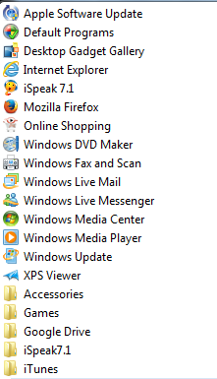
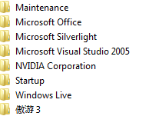
User
Excel 2013
PowerPoint 2013
Word 2013
Close “More”
Log Off
8:00PM
1/1/2014

Slide 13
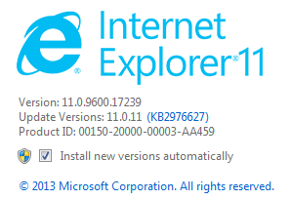

8:00PM
1/1/2014

Slide 14
8:00PM
1/1/2014

Slide 15

8:00PM
1/1/2014

Slide 16

8:00PM
1/1/2014

Slide 17
In Media Player, you could use this to put videos in it.
8:00PM
1/1/2014

