Slide 1
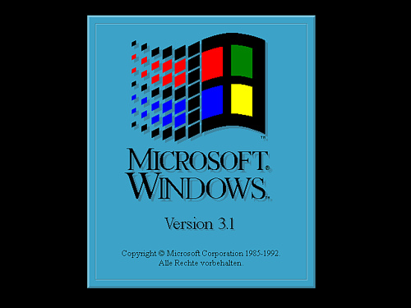


Slide 2




Program Manager
W
Microsoft
Office
Word 1992
Paint
Computer
Help
Shut Down

Slide 3
Computer
Program Manager
Win32
W
Microsoft
Office
Word 1992
Paint
Computer
Help
Shut Down

Slide 4
Computer
Error
Win32 Is Access Denied
Program Manager
Win32
W
Microsoft
Office
Word 1992
Paint
Computer
Help
Shut Down

Slide 5
Microsoft Office Word 1992
Program Manager
W
Microsoft
Office
Word 1992
Paint
Computer
Help
Shut Down

Slide 6
Paint
Program Manager
W
Microsoft
Office
Word 1992
Paint
Computer
Help
Shut Down

Slide 7
Help
Its Windows 3.1 For Crying Out Loud
Just Click On A Program And Run It.
Program Manager
W
Microsoft
Office
Word 1992
Paint
Computer
Help
Shut Down

