Slide 1
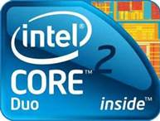
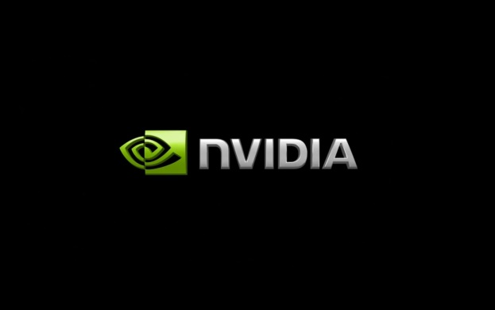
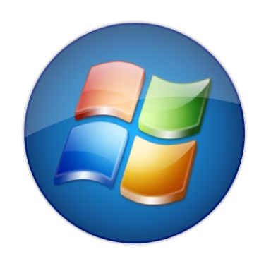

Loading Files

Slide 2
Loading Files.

Slide 3
Loading Files..

Slide 4
Loading Files…

Slide 5
Loading Files… Done!

Slide 6
Loading Files… Done!
Powering Cpu

Slide 7
Loading Files… Done!
Powering Cpu.

Slide 8
Loading Files… Done!
Powering Cpu..

Slide 9
Loading Files… Done!
Powering Cpu…

Slide 10
Loading Files… Done!
Powering Cpu… Done!

Slide 11
Loading Files… Done!
Powering Cpu… Done!
Loading System32

Slide 12
Loading Files… Done!
Powering Cpu… Done!
Loading System32.

Slide 13
Loading Files… Done!
Powering Cpu… Done!
Loading System32..

Slide 14
Loading Files… Done!
Powering Cpu… Done!
Loading System32…

Slide 15
Loading Files… Done!
Powering Cpu… Done!
Loading System32… Done!

Slide 16
Loading Files… Done!
Powering Cpu… Done!
Loading System32… Done!
Loading Windows Orbis Microsoft Corp. 2015

Slide 17
Loading Files… Done!
Powering Cpu… Done!
Loading System32… Done!
Loading Windows Orbis Microsoft Corp. 2015.

Slide 18
Loading Files… Done!
Powering Cpu… Done!
Loading System32… Done!
Loading Windows Orbis Microsoft Corp. 2015..

Slide 19
Loading Files… Done!
Powering Cpu… Done!
Loading System32… Done!
Loading Windows Orbis Microsoft Corp. 2015…

Slide 20
Loading Files… Done!
Powering Cpu… Done!
Loading System32… Done!
Loading Windows Orbis Microsoft Corp. 2015… Done!

Slide 21
Loading Files… Done!
Powering Cpu… Done!
Loading System32… Done!
Loading Windows Orbis Microsoft Corp. 2015… Done!
Loading Nvidia Grapics Card

Slide 22
Loading Files… Done!
Powering Cpu… Done!
Loading System32… Done!
Loading Windows Orbis Microsoft Corp. 2015… Done!
Loading Nvidia Grapics Card.

Slide 23
Loading Files… Done!
Powering Cpu… Done!
Loading System32… Done!
Loading Windows Orbis Microsoft Corp. 2015… Done!
Loading Nvidia Grapics Card..

Slide 24
Loading Files… Done!
Powering Cpu… Done!
Loading System32… Done!
Loading Windows Orbis Microsoft Corp. 2015… Done!
Loading Nvidia Grapics Card…

Slide 25
Loading Files… Done!
Powering Cpu… Done!
Loading System32… Done!
Loading Windows Orbis Microsoft Corp. 2015… Done!
Loading Nvidia Grapics Card…
Getting Ready To Start Windows

Slide 26
Loading Files… Done!
Powering Cpu… Done!
Loading System32… Done!
Loading Windows Orbis Microsoft Corp. 2015… Done!
Loading Nvidia Grapics Card…
Getting Ready To Start Windows.

Slide 27
Loading Files… Done!
Powering Cpu… Done!
Loading System32… Done!
Loading Windows Orbis Microsoft Corp. 2015… Done!
Loading Nvidia Grapics Card…
Getting Ready To Start Windows..

Slide 28
Loading Files… Done!
Powering Cpu… Done!
Loading System32… Done!
Loading Windows Orbis Microsoft Corp. 2015… Done!
Loading Nvidia Grapics Card…
Getting Ready To Start Windows…

Slide 29
Please Wait While Windows Confiugures
Intel,Nvidia,Acer Drivers

Slide 30
Please Wait While Windows Confiugures
Intel,Nvidia,Acer Drivers

Slide 31
Please Wait While Windows Confiugures
Intel,Nvidia,Acer Drivers

Slide 32
Please Wait While Windows Confiugures
Intel,Nvidia,Acer Drivers

Slide 33
Please Wait While Windows Confiugures
Intel,Nvidia,Acer Drivers Done!

Slide 34
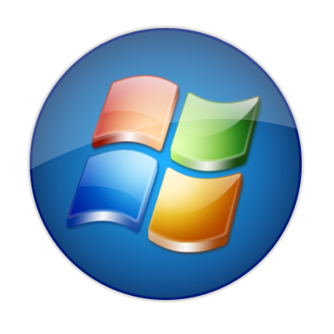
Please Wait..

Slide 35
Please Wait..

Slide 36
Please Wait..

Slide 37
Please Wait..

Slide 38
Please Wait..

Slide 39
Please Wait..

Slide 40
Please Wait..

Slide 41
Please Wait..

Slide 42
Please Wait..

Slide 43
Please Wait..

Slide 44
Please Wait..

Slide 45
Please Wait..

Slide 46
Please Wait..

Slide 47
Please Wait..

Slide 48
Please Wait..

Slide 49
Please Wait..

Slide 50
Please Wait..

Slide 51
Please Wait..

Slide 52
Please Wait..

Slide 53
Please Wait..

Slide 54
Please Wait..

Slide 55
Please Wait..

Slide 56
Please Wait..

Slide 57
Please Wait..

Slide 58
Please Wait..

Slide 59
Please Wait..

Slide 60
Please Wait..

Slide 61
Please Wait..

Slide 62
Please Wait..

Slide 63
Please Wait..

Slide 64
Please Wait..

Slide 65
Please Wait..

Slide 66
Please Wait..

Slide 67
Please Wait..

Slide 68
Please Wait..

Slide 69
Please Wait..

Slide 70
Please Wait..

Slide 71
Please Wait..

Slide 72
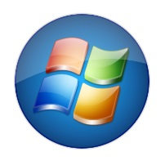
Welcome
Windows Orbis Ultimate

Slide 75
Orbis

Slide 76

Orbis

Slide 77
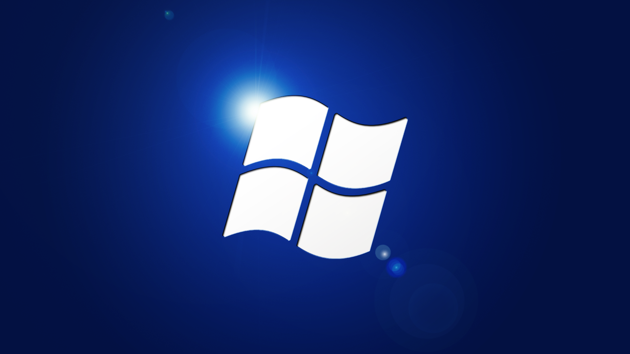
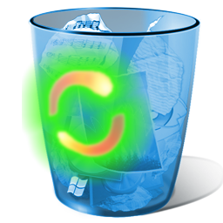

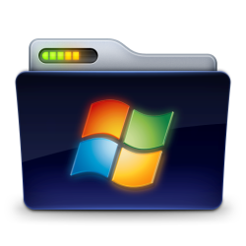






Recycle
Bin
Microsoft
Office 2014
Windows
Orbis
Marketplace
Windows Explorer
Internet Explorer 11
Windows Care
Course
Notepad
Pro
Windows Media Player

Slide 78

Windows Explorer
x
Recycle
Bin
Microsoft
Office 2014
Windows
Orbis
Marketplace
Windows Explorer
Internet Explorer 11
Windows Care
Course
Notepad
Pro
Windows Media Player

Slide 79
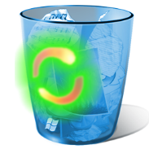
Recycle Bin
The Recycle Bin Is Empty
x
Recycle
Bin
Microsoft
Office 2014
Windows
Orbis
Marketplace
Windows Explorer
Internet Explorer 11
Windows Care
Course
Notepad
Pro

Slide 80



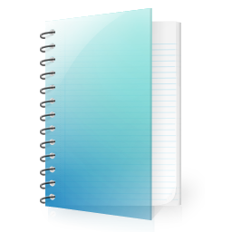
Start
Windows Explorer
wot
All Programs
Settings

Slide 81


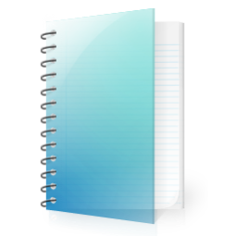

Start
wot
Windows Explorer
All Programs
Settings

Slide 82
Windows Orbis Tour.
Interface
Programs
Light And
Speedy
Close

Slide 83
Interface
A New Easy To Use
Interface Is Here
More Better Looking
Than Ever Before
With Your Metro
Still Alongside.

Slide 84


Interface
Windows Orbis
A New Begining

Slide 85
Interface
Tour
Home
Replay

Slide 86
Light And Speedy
With The Windows Orbis Os You
Will Zoom Through Everything!

Slide 87
Light And Speedy
Faster Than The
Human Eye!

Slide 88
Light And Speedy
Exactly Like This

Slide 89

Light And Speedy

Slide 90
Light And Speedy
This Is Beacause
Orbis Is A Light Os
With A Very Good
Speed.

Slide 91
Light And Speedy
Zoom!

Slide 92
Light And Speedy
Orbis Is A
New Era Of
Computer’s

Slide 93
Light And Speedy
Windows Orbis
A New Begining

Slide 94
Light And Speedy
Tour
Home
Replay

Slide 95
Programs
In Windows Orbis There Are
Many
New Programs.

Slide 96
Programs
Plus There Are A lot Of
Updated Programs

Slide 97
Programs
And A lot Of The Normal
Pay For Programs Like
Microsoft Office Now
Come Free With The Os!

Slide 98
Programs
You Will Now See The
Programs

Slide 99
Programs
Internet Explorer
11
Faster And Sleeker
Than Ever Before

Slide 100




Programs
Microsoft Office
2014

Slide 101
Programs
Notepad Pro
Notepad Pro Is A New Windows
Program For Versions Of Windows All
The Way Down To Windows Xp
For Other Windows It Is £49.34
But It Comes Free With Orbis.

Slide 102
Programs
Windows
Care Course
A New Antivirus For
Windows That Come’s
Free With Orbis, Firewall
Has Been Removed But This Is
10x Better Acording to Developers!

Slide 103
Programs
Media Player
13
A New Look And New
Features And It Is
Speedy And Original

Slide 104

Programs
Windows Orbis
Marketplace
An Easy To Use
Download Client
For Windows Orbis!

Slide 105
Programs
Windows Orbis
A New Begining

Slide 106
Programs
Tour
Home
Replay

Slide 107
Goodbye

