Slide 1

Windows XP
Microsoft
xp
Windows
Windows XP Metro Redesign V2
Designed and Developed By: Alex Apple
Website: aacompware.com
YouTube: /missouri.musician
System Icons Designed By: Icons8
All Icons released under CC BY-ND 3.0
Check them out at icons8.com
This template is released under CC BY 4.0
You can make adaptations of this work and use
it for commercial purposes. However, you need
to give me credit.

Slide 2


F2 = System Setup
F10 = System Services
F11 = BIOS Boot Manager
F12 = PXE Boot
www.aacompware.com
PowerPoint 2016
BIOS Revision 2.1.0

Slide 3

Copyright © Microsoft Corporation

Slide 4
Copyright © Microsoft Corporation

Slide 5
Copyright © Microsoft Corporation

Slide 6
Copyright © Microsoft Corporation

Slide 7
Copyright © Microsoft Corporation

Slide 8
Copyright © Microsoft Corporation

Slide 9
Copyright © Microsoft Corporation

Slide 10
Copyright © Microsoft Corporation

Slide 11
Copyright © Microsoft Corporation

Slide 12
Copyright © Microsoft Corporation

Slide 13
Copyright © Microsoft Corporation

Slide 14
Copyright © Microsoft Corporation

Slide 15
Copyright © Microsoft Corporation

Slide 16
Copyright © Microsoft Corporation

Slide 17
Copyright © Microsoft Corporation

Slide 18
Copyright © Microsoft Corporation

Slide 19
Copyright © Microsoft Corporation

Slide 20
Copyright © Microsoft Corporation

Slide 21
Copyright © Microsoft Corporation

Slide 22
Copyright © Microsoft Corporation

Slide 23
Copyright © Microsoft Corporation

Slide 24
Copyright © Microsoft Corporation

Slide 25
Copyright © Microsoft Corporation

Slide 26
Copyright © Microsoft Corporation

Slide 27
Copyright © Microsoft Corporation

Slide 28
Copyright © Microsoft Corporation

Slide 29
Copyright © Microsoft Corporation

Slide 30
Copyright © Microsoft Corporation

Slide 31
Copyright © Microsoft Corporation

Slide 32
Copyright © Microsoft Corporation

Slide 33
Copyright © Microsoft Corporation

Slide 34
Copyright © Microsoft Corporation

Slide 35
Copyright © Microsoft Corporation

Slide 36
Copyright © Microsoft Corporation

Slide 37
Copyright © Microsoft Corporation

Slide 38
Copyright © Microsoft Corporation

Slide 39
Copyright © Microsoft Corporation

Slide 40
Copyright © Microsoft Corporation

Slide 41
Copyright © Microsoft Corporation

Slide 42
Copyright © Microsoft Corporation

Slide 43
Copyright © Microsoft Corporation

Slide 44
Copyright © Microsoft Corporation

Slide 45
Copyright © Microsoft Corporation

Slide 46
Copyright © Microsoft Corporation

Slide 47
Copyright © Microsoft Corporation

Slide 48
Copyright © Microsoft Corporation

Slide 49
Copyright © Microsoft Corporation

Slide 50
Copyright © Microsoft Corporation

Slide 51
Copyright © Microsoft Corporation

Slide 52
Copyright © Microsoft Corporation

Slide 53
Copyright © Microsoft Corporation

Slide 54
Copyright © Microsoft Corporation

Slide 55
Copyright © Microsoft Corporation

Slide 56
Copyright © Microsoft Corporation

Slide 57
Copyright © Microsoft Corporation

Slide 58
Copyright © Microsoft Corporation

Slide 59
Copyright © Microsoft Corporation

Slide 60
Copyright © Microsoft Corporation

Slide 61
Copyright © Microsoft Corporation

Slide 62
Copyright © Microsoft Corporation

Slide 63
Copyright © Microsoft Corporation

Slide 66

Please Wait…

Slide 67




User
Password
Turn off computer
After you log on, you can add or change accounts.
Just go to Control Panel and click User Accounts.

Slide 68
welcome

Slide 69
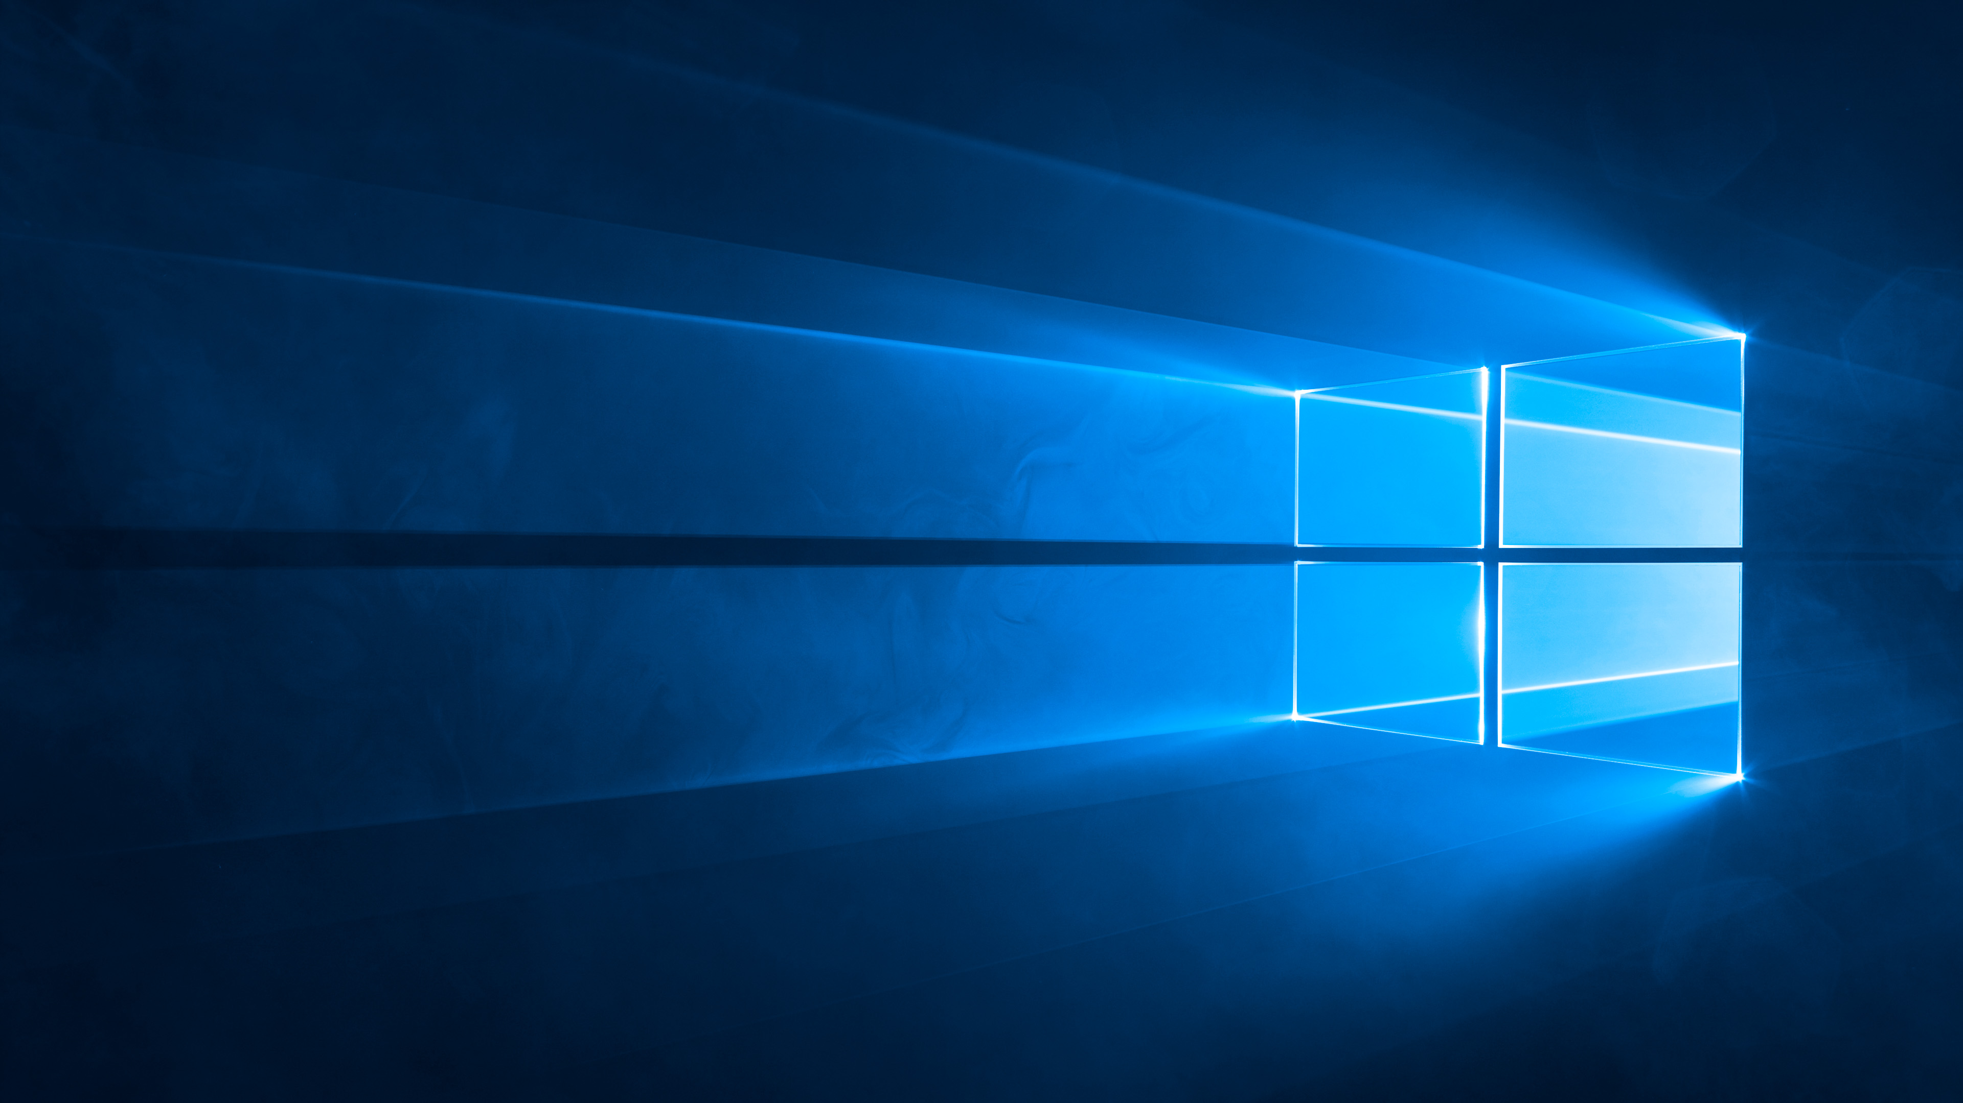


Recycling
Bin
start
12:00 AM
12/12/2012

Slide 70
Recycling
Bin
start
12:00 AM
12/12/2012

Slide 71

Recycling
Bin
My Music
X
File Edit View Favorites Tools Help
← → ↑
C:\Documents and Settings\user\My Documents\My Music
Search My Music
File and Folder Tasks ↓
Other Places ↓
Details ↑
My Music
File Folder
Date Modified: Today, December 12, 2012, 12:00 AM
start
12:00 AM
12/12/2012

Slide 72
Recycling
Bin
My Pictures
X
File Edit View Favorites Tools Help
← → ↑
C:\Documents and Settings\user\My Documents\My Pictures
Search My Pictures
File and Folder Tasks ↓
Other Places ↓
Details ↑
My Pictures
File Folder
Date Modified: Today, December 12, 2012, 12:00 AM
start
12:00 AM
12/12/2012

Slide 73
Recycling
Bin
My Videos
X
File Edit View Favorites Tools Help
← → ↑
C:\Documents and Settings\user\My Documents\My Videos
Search My Videos
File and Folder Tasks ↓
Other Places ↓
Details ↑
My Videos
File Folder
Date Modified: Today, December 12, 2012, 12:00 AM
start
12:00 AM
12/12/2012

Slide 74

Recycling
Bin
My Documents
X
File Edit View Favorites Tools Help
← → ↑
C:\Documents and Settings\user\My Documents
Search My Documents
File and Folder Tasks ↓
My Pictures
Other Places ↓
My Music
Details ↑
My Documents
File Folder
Date Modified: Today, December 12, 2012, 12:00 AM
My Videos
start
12:00 AM
12/12/2012

Slide 75
Recycling
Bin
Shared Documents
X
File Edit View Favorites Tools Help
← → ↑
C:\Documents and Settings\All Users\Shared Documents
Search Shared Documents
File and Folder Tasks ↓
Shared Pictures
Other Places ↓
Shared Music
Details ↑
Shared Documents
File Folder
Date Modified: Today, December 12, 2012, 12:00 AM
Shared Videos
start
12:00 AM
12/12/2012

Slide 76
Recycling
Bin
C:\
X
File Edit View Favorites Tools Help
← → ↑
C:\
Search C: Drive
File and Folder Tasks ↓
Documents and Settings
Other Places ↓
Program Files
Details ↑
C:\
Hard Disk Drive
Date Modified: Today, December 12, 2012, 12:00 AM
Windows
WUTemp
start
12:00 AM
12/12/2012

Slide 77









Recycling
Bin
My Computer
X
File Edit View Favorites Tools Help
← → ↑
My Computer
Search My Computer
Files Stored on This Computer
System Tasks ↑
View system information
Shared Documents
User’s Documents
Add or remove programs
Change a setting
Hard Disk Drives
Other Places ↑
My Network Places
WINDOWS (C:)
BACKUP (D:)
My Documents
Shared Documents
Control Panel
Devices with Removable Storage
Details ↑
My Computer
System Folder
3½ Floppy (A:)
DVD/CD-RW Drive (G:)
start
12:00 AM
12/12/2012

Slide 78


Recycling
Bin
My Network Places
X
File Edit View Favorites Tools Help
← → ↑
My Network Places
Search is not available for this location
Local Network Locations
Network Tasks ↑
Add a network place
Shared Documents
View network connections
Set up a home or small
office network
Set up a wireless network
for a home or small office
The Internet
View workgroup computers
My Web Sites on MSN
Hide icons for networked
UPnP devices
Other Places ↑
My Computer
My Documents
Shared Documents
Control Panel
Details ↓
start
12:00 AM
12/12/2012

Slide 79

Recycling
Bin
My Computer
X
File Edit View Favorites Tools Help
← → ↑
My Computer
Search My Computer
Files Stored on This Computer
System Tasks ↑
View system information
Shared Documents
User’s Documents
Add or remove programs
Change a setting
Hard Disk Drives
Other Places ↑
D:
X
My Network Places
WINDOWS (C:)
D:\ is not accessible.
Access is denied.
BACKUP (D:)
My Documents
Shared Documents
Control Panel
OK
Devices with Removable Storage
Details ↑
My Computer
System Folder
3½ Floppy (A:)
DVD/CD-RW Drive (G:)
start
12:00 AM
12/12/2012

Slide 80
Recycling
Bin
My Computer
X
File Edit View Favorites Tools Help
← → ↑
My Computer
Search My Computer
Files Stored on This Computer
System Tasks ↑
View system information
Shared Documents
User’s Documents
Add or remove programs
Change a setting
Hard Disk Drives
Other Places ↑
Windows – No Disk
X
My Network Places
There is no disk in the drive. Please insert a disk into drive .
My Documents
WINDOWS (C:)
BACKUP (D:)
Shared Documents
Control Panel
Cancel
Try Again
Continue
Devices with Removable Storage
Details ↑
My Computer
System Folder
3½ Floppy (A:)
DVD/CD-RW Drive (G:)
start
12:00 AM
12/12/2012

Slide 81
Recycling
Bin
System Properties
?
X
System Restore
Automatic Updates
Remote
My Computer
X
General
Computer Name
Hardware
Advanced
File Edit View Favorites Tools Help
System:
Microsoft Windows XP
Professional
Version 2016
Service Pack 5
Registered to:
MoMusician
12345-000-6789123-23456
Computer:
Intel® Core™ i5 CPU
3570K @ 3.40GHz
3.40GHz, 24 GB of RAM
← → ↑
My Computer
Search My Computer
Files Stored on This Computer
System Tasks ↑
View system information
Shared Documents
User’s Documents
Add or remove programs
Change a setting
Hard Disk Drives
Other Places ↑
My Network Places
WINDOWS (C:)
BACKUP (D:)
My Documents
Shared Documents
Control Panel
Devices with Removable Storage
Details ↑
My Computer
System Folder
3½ Floppy (A:)
DVD/CD-RW Drive (G:)
OK
Cancel
Apply
start
12:00 AM
12/12/2012

Slide 82

















Recycling
Bin
Control Panel
X
File Edit View Favorites Tools Help
← → ↑
Control Panel
Search Control Panel
Control Panel ↑
Pick a category
Switch to Classic View
Appearance and Themes
Printers and Other Hardware
See Also ↑
Windows Update
Network and Internet Connections
User Accounts
Help and Support
Other Control Panel
Options
Add or Remove Programs
Date, Time, Language, and Regional
Options
Sounds, Speech, and Audio Devices
Accessibility Options
Performance and Maintenance
Security Center
start
12:00 AM
12/12/2012

Slide 83
Recycling
Bin
User
My Documents
My Recent Documents
My Pictures
My Music
My Computer
Control Panel
Set Program Defaults
Connect To →
Printers and Faxes
Help and Support
Search
All Programs
Run…
Log Off
Turn Off Computer
start
12:00 AM
12/12/2012

Slide 84
Logging Off…

Slide 85
Shutting Down…

Slide 86
It now safe to turn off your computer

