Slide 1
Microsoft
xp
Windows

Slide 2
Microsoft
xp
Windows

Slide 3
Microsoft
xp
Windows

Slide 4
Microsoft
xp
Windows

Slide 5
Microsoft
xp
Windows

Slide 6
Microsoft
xp
Windows

Slide 7
Microsoft
xp
Windows

Slide 8
Microsoft
xp
Windows

Slide 9
Microsoft
xp
Windows

Slide 10
Microsoft
xp
Windows

Slide 11
Microsoft
xp
Windows

Slide 12
Microsoft
xp
Windows

Slide 13
Microsoft
xp
Windows

Slide 14
Microsoft
xp
Windows

Slide 15
Microsoft
xp
Windows

Slide 16
Microsoft
xp
Windows

Slide 17
Microsoft
xp
Windows

Slide 18
Microsoft
xp
Windows

Slide 19
Microsoft
xp
Windows

Slide 20
Microsoft
xp
Windows

Slide 21
Microsoft
xp
Windows

Slide 22
Microsoft
xp
Windows

Slide 23
Microsoft
xp
Windows

Slide 24
Microsoft
xp
Windows

Slide 25
Microsoft
xp
Windows

Slide 26
Microsoft
xp
Windows

Slide 27
Microsoft
xp
Windows

Slide 28
Microsoft
xp
Windows

Slide 29
Microsoft
xp
Windows

Slide 30
Microsoft
xp
Windows

Slide 31
Microsoft
xp
Windows

Slide 32
Microsoft
xp
Windows

Slide 33
Microsoft
xp
Windows

Slide 34
Microsoft
xp
Windows

Slide 35
Microsoft
xp
Windows

Slide 36
Microsoft
xp
Windows

Slide 37
Microsoft
xp
Windows

Slide 38
Microsoft
xp
Windows

Slide 39
Microsoft
xp
Windows

Slide 40
Microsoft
xp
Windows

Slide 41
Microsoft
xp
Windows

Slide 42
Microsoft
xp
Windows

Slide 43
Microsoft
xp
Windows

Slide 44
Microsoft
xp
Windows

Slide 45
Microsoft
xp
Windows

Slide 46
Microsoft
xp
Windows

Slide 47
Microsoft
xp
Windows

Slide 48
Microsoft
xp
Windows

Slide 49
Microsoft
xp
Windows

Slide 50
Microsoft
xp
Windows

Slide 51
Microsoft
xp
Windows

Slide 52
Microsoft
xp
Windows

Slide 53
Microsoft
xp
Windows

Slide 54
Microsoft
xp
Windows

Slide 55
Microsoft
xp
Windows

Slide 56
Microsoft
xp
Windows

Slide 57
Microsoft
xp
Windows

Slide 58
Microsoft
xp
Windows

Slide 59
Microsoft
xp
Windows

Slide 60
Microsoft
xp
Windows

Slide 61
Microsoft
xp
Windows

Slide 62
Microsoft
xp
Windows

Slide 65
Windows
xp
Windows is starting up….

Slide 66


adrian
Windows
xp
admin

Slide 67
adrian

Slide 68
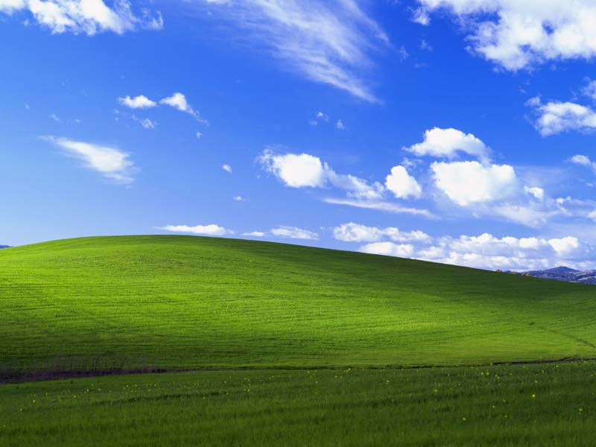
start
12:00 AM

Slide 69
start
12:00 AM

Slide 70
adrian
My Computer
Log Off
Shut Down
start
12:00 AM

