Slide 2

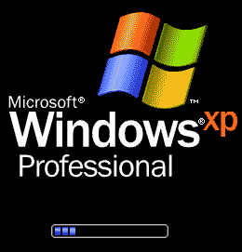

Copyright © Microsoft Corporation

Slide 3
Copyright © Microsoft Corporation

Slide 4


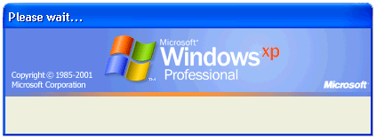


Saving your personal settings…

Slide 5
Loading your personal settings…

Slide 7


start
12:00 AM

Slide 8









MoMusician
Internet
Internet Explorer
My Documents
Email
Outlook Express
My Pictures
My Music
MSN Explorer
My Computer
Windows Media Player
Control Panel
Windows Live Movie Maker
Printers and Faxes
Freecell
Help and Support
Search
Run…
All Programs
Log Off
Turn Off Computer
start
12:00 AM

