Slide 1

Luna PowerPoint SP2
This template is released under CC BY 4.0
You can make adaptations of this work and use
it for commercial purposes. However, you need
to give me credit.
Designed and Developed By: Alex Apple
Website: aacompware.com
YouTube: /missouri.musician

Slide 2
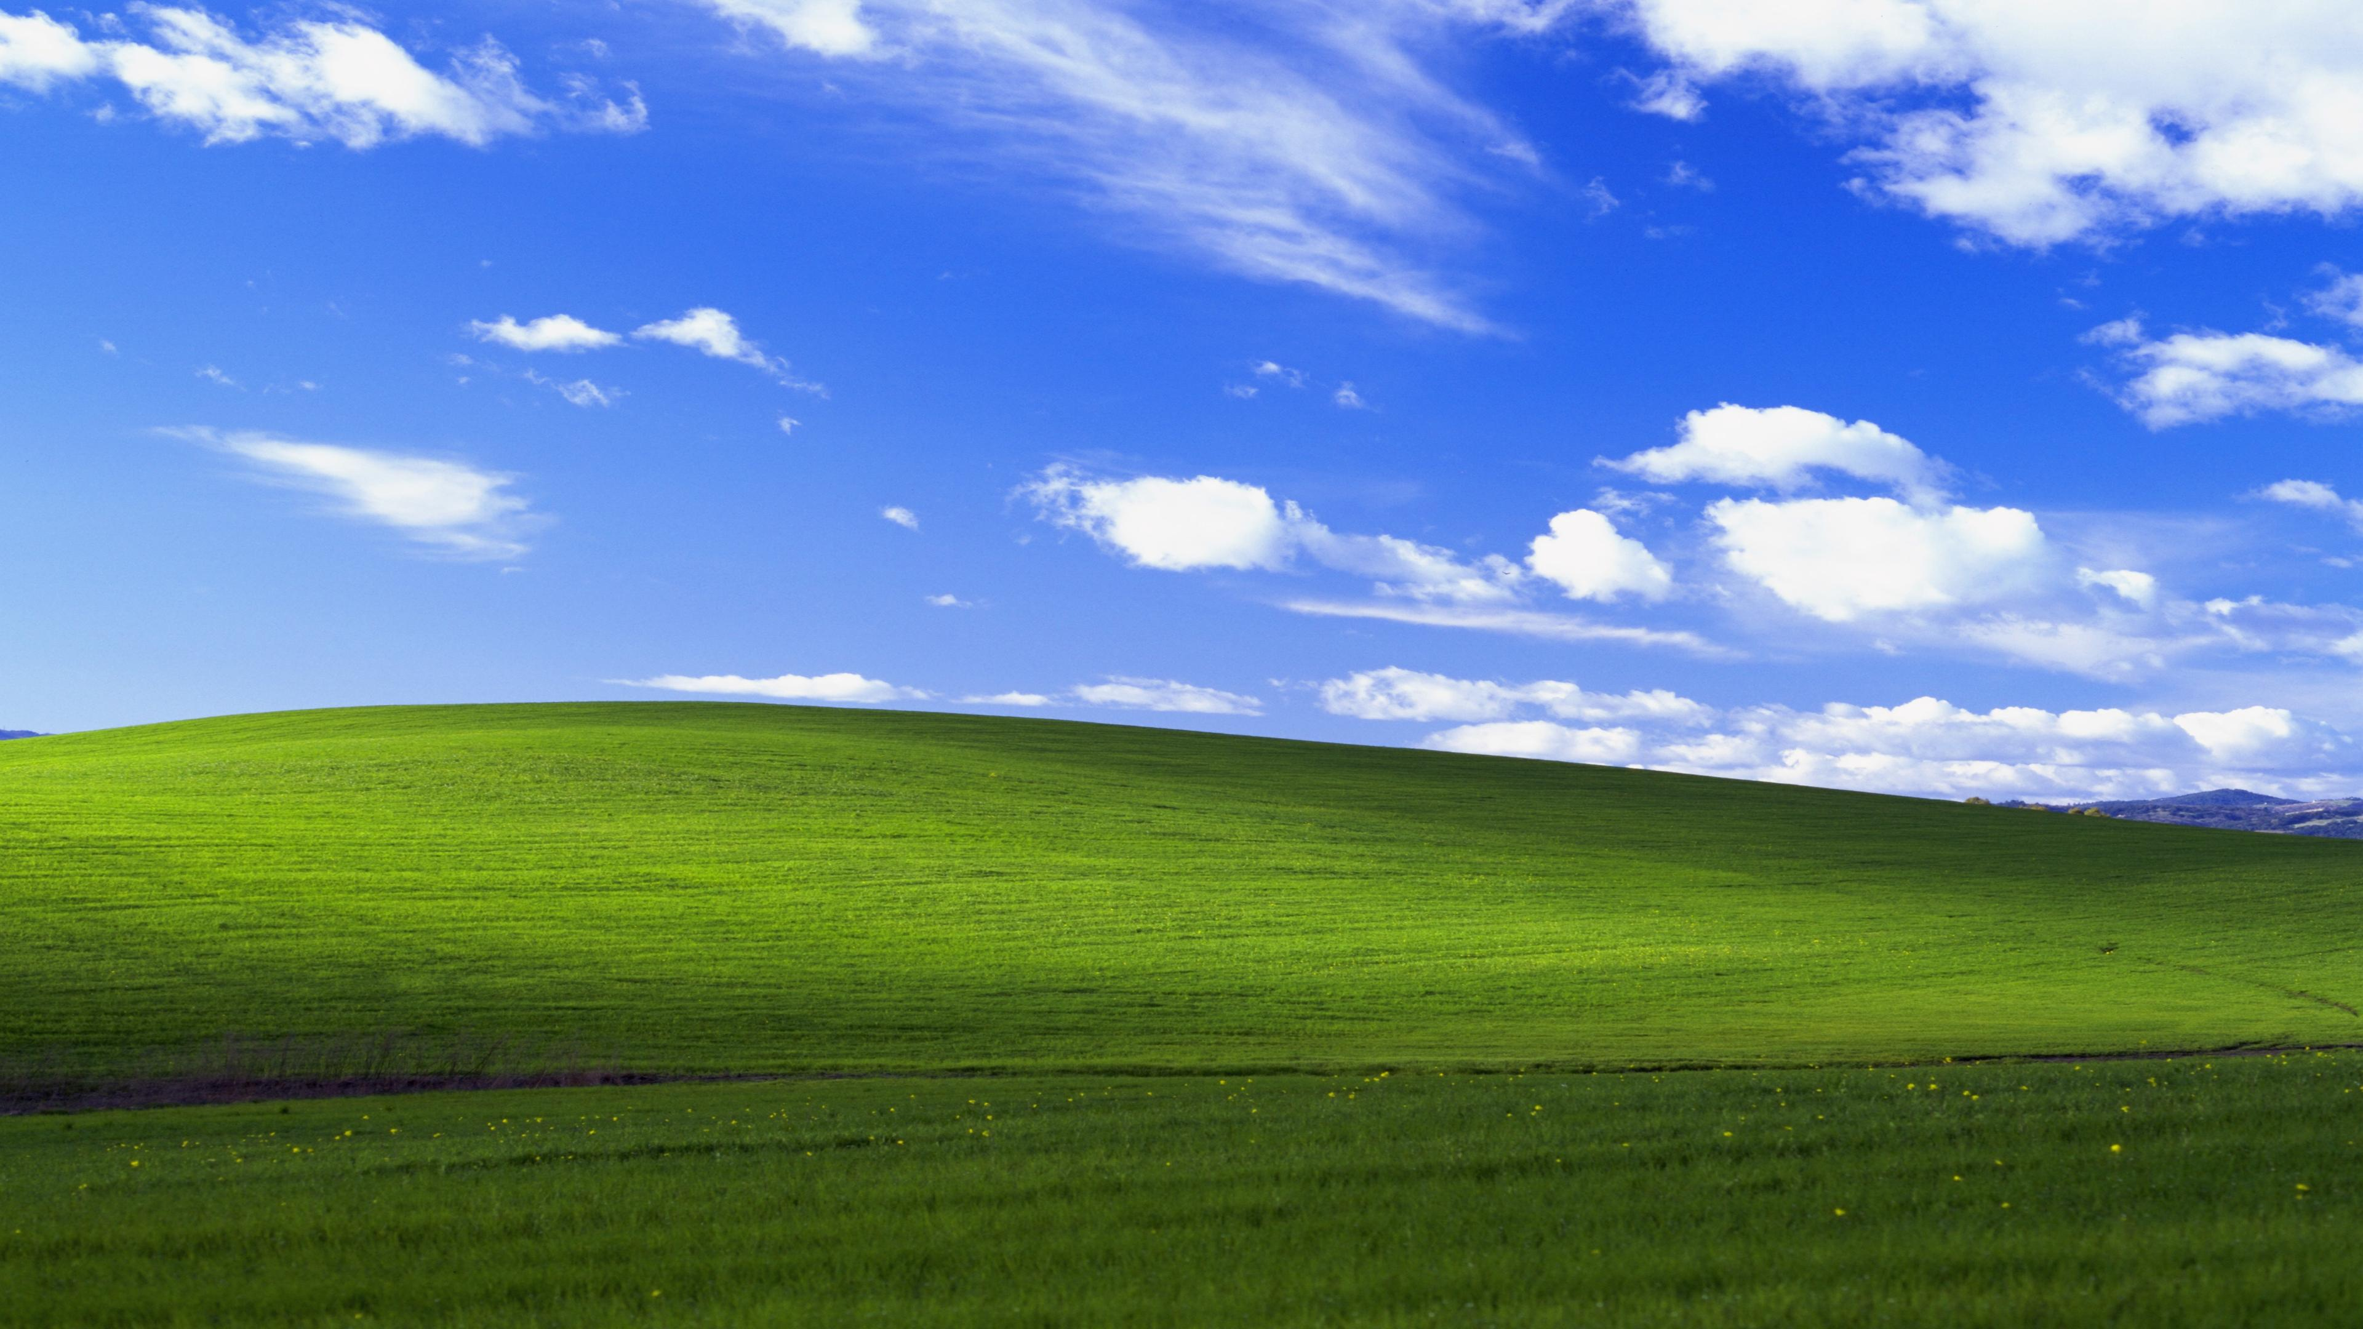
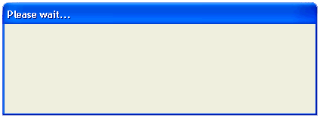
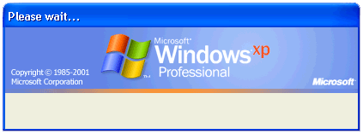


Shutting down…
Saving your personal settings…

Slide 4
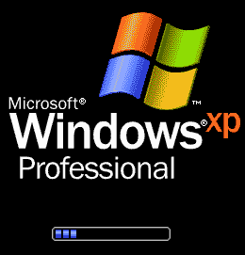

Copyright © Microsoft Corporation

Slide 5
Copyright © Microsoft Corporation

Slide 6
Windows is starting up…

Slide 7
Saving your personal settings…

Slide 8
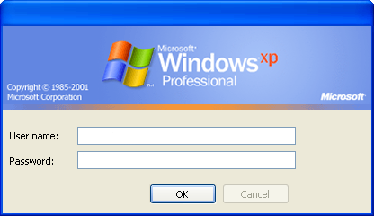
Log On to Windows

Slide 9
Loading your personal settings…

Slide 11


start
12:00 AM

Slide 12

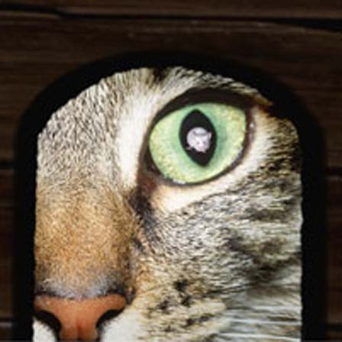







MoMusician
Internet
Internet Explorer
My Documents
Email
Outlook Express
My Pictures
My Music
MSN Explorer
My Computer
Windows Media Player
Control Panel
Windows Live Movie Maker
Printers and Faxes
Freecell
Help and Support
Search
Run…
All Programs
Log Off
Turn Off Computer
start
12:00 AM

Slide 13


Log off computer
No Icons Yet
start
12:00 AM

Slide 14
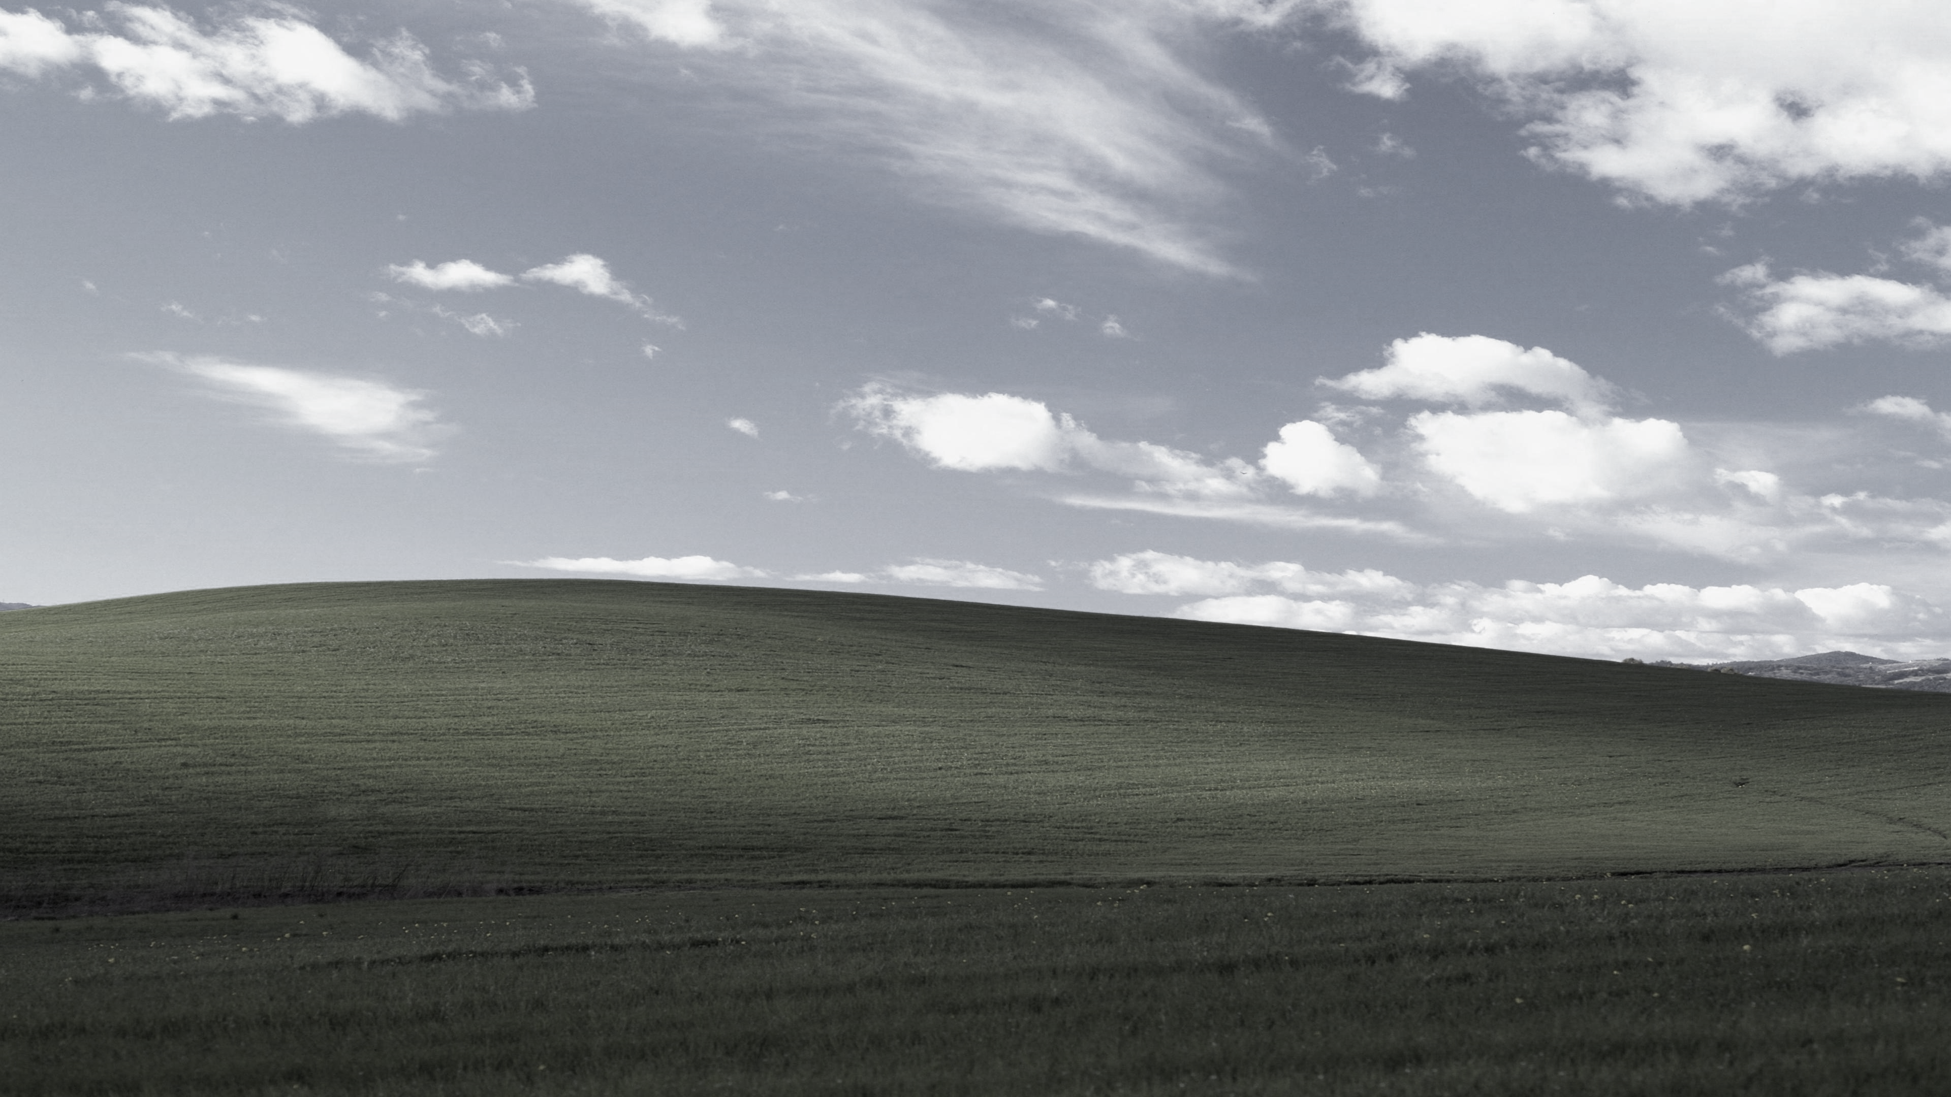


Log off computer
No Icons Yet
start
12:00 AM

Slide 15


Turn off computer
Stand By
Turn Off
Restart
start
12:00 AM

Slide 16
Turn off computer
Stand By
Turn Off
Restart
start
12:00 AM

Slide 17





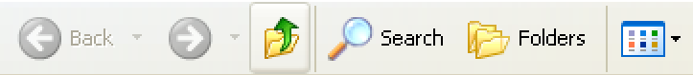
My Computer
File
Edit
View
Favorites
Tools
Help
Address
My Computer
System Tasks
Hard Disk Drives
View system information
Add or remove programs
Change a setting
Devices with Removable Storage
Other Places
My Network Places
My Documents
Control Panel
Details
My Computer
System Folder
start
My Computer
12:00 AM

Slide 18
start
My Computer
12:00 AM

Slide 19
Shutting down…
Saving your personal settings…

Slide 20
It is now safe to exit the presentation…

