Slide 1
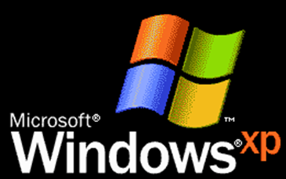
Luna PowerPoint SP3
This template is released under CC BY 4.0
You can make adaptations of this work and use
it for commercial purposes. However, you need
to give me credit.
Designed and Developed By: Alex Apple
Website: aacompware.com
YouTube: /missouri.musician

Slide 2
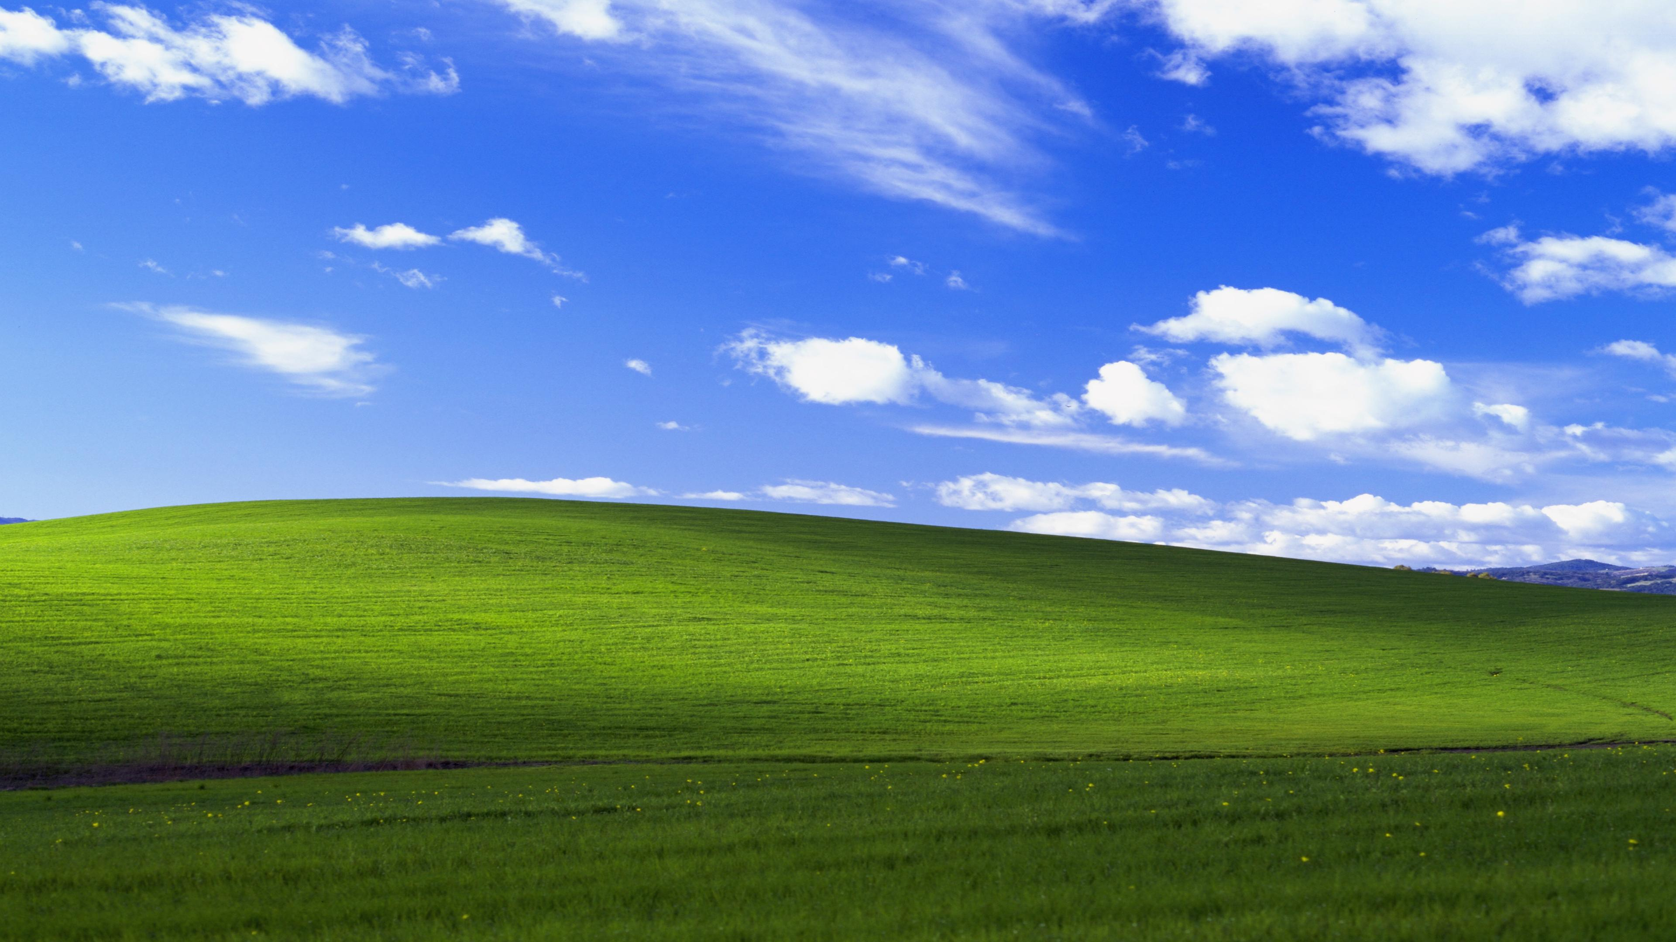
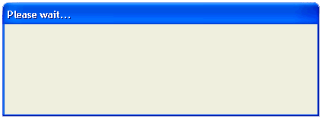
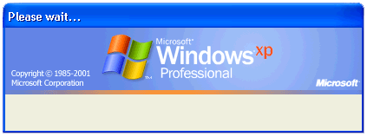


Shutting down…
Saving your personal settings…

Slide 4


Microsoft®
Windows
xp
Copyright © Microsoft Corporation

Slide 5
Microsoft®
Windows
xp
Copyright © Microsoft Corporation

Slide 8
Microsoft®
xp
Windows
Windows is starting up..
Windows is starting up.
Windows is starting up...

Slide 9
Microsoft®
xp
Windows
Saving your settings...
Saving your settings..
Saving your settings.

Slide 10
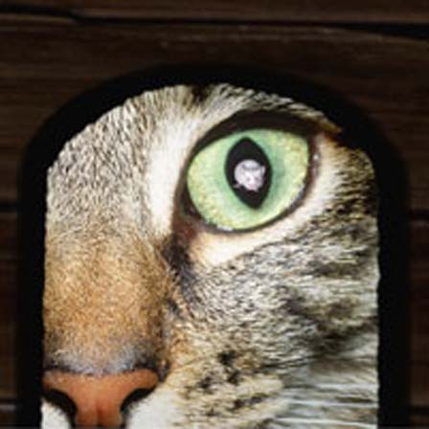

MoMusician
Microsoft®
xp
Windows
Guest
To begin, click your user name
Turn off computer
After you log on, you can add or change accounts.
Just go to Control Panel and click User Accounts.

Slide 11
MoMusician
Microsoft®
xp
Windows
Guest
Loading your personal settings…
To begin, click your user name
Turn off computer
After you log on, you can add or change accounts.
Just go to Control Panel and click User Accounts.

Slide 12
welcome

Slide 13
Windows is starting up…

Slide 14
Saving your personal settings…

Slide 15
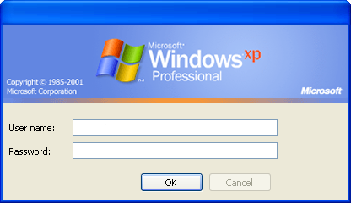
Log On to Windows

Slide 16
Loading your personal settings…

Slide 18

start
12:00 AM

Slide 19



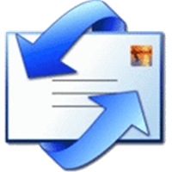



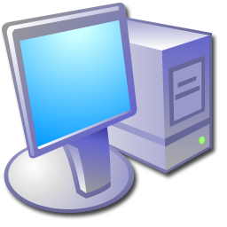
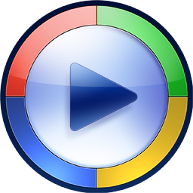










MoMusician
Internet
Internet Explorer
My Documents
Email
Outlook Express
My Pictures
My Music
MSN Explorer
My Computer
Windows Media Player
Control Panel
Windows Live Movie Maker
Printers and Faxes
Freecell
Help and Support
Spider Solitaire
Search
Run…
Minesweeper
All Programs
Log Off
Turn Off Computer
start
12:00 AM

Slide 20
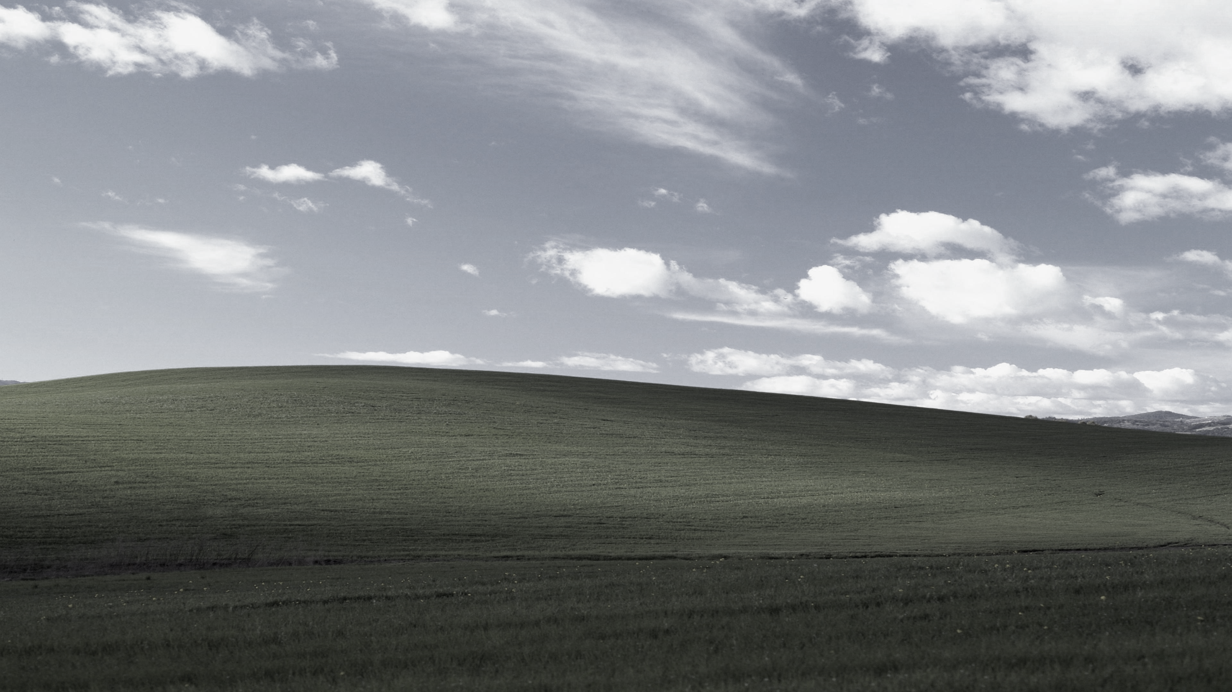




Log off computer
Log Off
start
start
12:00 AM
12:00 AM

Slide 21


Turn off computer
Stand By
Turn Off
Restart
start
start
12:00 AM
12:00 AM

Slide 22





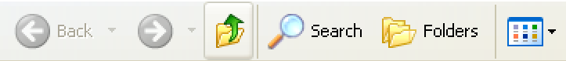





My Computer
File
Edit
View
Favorites
Tools
Help
Address
My Computer
System Tasks
Hard Disk Drives
View system information
Local Disk (C:)
Add or remove programs
Change a setting
Devices with Removable Storage
Other Places
My Network Places
DVD Disk Drive (D:)
Removable Disk (F:)
My Documents
Control Panel
Details
My Computer
System Folder
start
My Computer
12:00 AM

Slide 23

My Computer
File
Edit
View
Favorites
Tools
Help
Address
My Computer
System Tasks
Hard Disk Drives
View system information
Local Disk (C:)
Add or remove programs
Change a setting
Devices with Removable Storage
Other Places
My Network Places
DVD Disk Drive (D:)
Removable Disk (F:)
My Documents
Control Panel
Details
My Computer
System Folder
start
My Computer
12:00 AM

Slide 24
start
My Computer
12:00 AM

Slide 25
start
My Computer
12:00 AM

Slide 26
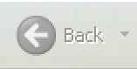

Local Disk (C:)
File
Edit
View
Favorites
Tools
Help
Address
Local Disk (C:)
System Tasks
These files are hidden.
View system information
This folder contains files that keep your system working properly. You should not modify its contents.
Add or remove programs
Change a setting
Other Places
My Network Places
My Documents
Control Panel
Details
Local Disk (C:)
Operating System Hard Disk
start
Local Disk (C:)
12:00 AM

Slide 27
Local Disk (C:)
File
Edit
View
Favorites
Tools
Help
Address
Local Disk (C:)
System Tasks
These files are hidden.
View system information
This folder contains files that keep your system working properly. You should not modify its contents.
Add or remove programs
Change a setting
Other Places
My Network Places
My Documents
Control Panel
Details
Local Disk (C:)
Operating System Hard Disk
start
Local Disk (C:)
12:00 AM

Slide 28
start
Local Disk (C:)
12:00 AM

Slide 29
start
Local Disk (C:)
12:00 AM

Slide 30










Control Panel
File
Edit
View
Favorites
Tools
Help
Address
Control Panel
Control Panel
Pick a category
Switch to Classic View
See Also
Appearance and Themes
Printers and Other Hardware
Windows Update
Help and Support
Network and Internet Connections
User Accounts
View x86 Control Panel Icons
Other Control Panel Options
Date, Time, Language, and Regional
Options
Add or Remove Programs
Sounds, Speech, and Audio Devices
Accessibility Options
Performance and Maintenance
start
Control Panel
12:00 AM

Slide 31
Control Panel
File
Edit
View
Favorites
Tools
Help
Address
Control Panel
Control Panel
Pick a category
Switch to Classic View
See Also
Appearance and Themes
Printers and Other Hardware
Windows Update
Help and Support
Network and Internet Connections
User Accounts
View x86 Control Panel Icons
Other Control Panel Options
Date, Time, Language, and Regional
Options
Add or Remove Programs
Sounds, Speech, and Audio Devices
Accessibility Options
Performance and Maintenance
start
Control Panel
12:00 AM

Slide 32
start
Control Panel
12:00 AM

Slide 33
start
Control Panel
12:00 AM

Slide 35
Microsoft®
xp
Windows
Saving your settings...
Saving your settings..
Saving your settings.

Slide 36
Microsoft®
xp
Windows
Shutting down..
Shutting down...
Shutting down.

Slide 37
It is now safe to exit the presentation…

